Slide 1
HIV Testing
Karen barclay
Health Adviser

Slide 2
Why?
1 in 8 people infected with HIV in the UK are unaware of their diagnosis (approx 13,500 people)
Early diagnosis is better:
easier and cheaper to rx if diagnosed earlier
diagnosis can reduce onward transmission
if HIV is diagnosed and treated promptly, clinical outcomes are better and life expectancy same as non HIV
Late Diagnosis is often a result of missed opportunities to test earlier!
Notes:
In 2012, an estimated 21,900 HIV positive people were unaware of their infection, the equivalent of 1 in 5 people living with HIV in the UK. In 2012, 6,360 people were newly diagnosed with HIV, and the largest number were among men who have sex with men (3,250) and heterosexual men and women (2,880). Infections acquired through other routes of transmission remain small.
Expansion of HIV screening and testing is a critical response to the challenge of controlling the HIV epidemic and reducing late HIV diagnosis. Programmes to increase HIV testing have been shown to be effective, cost-effective and provide a positive return on investment.

Slide 3
Who?
EVERYONE! – consider HIV testing along with routine blood tests
High Risk Populations:
HIV – differential diagnosis
Patients diagnosed with STI
MSM (and female contacts of MSM)
Patients with HIV + sexual partner
Hx of IVDU / other injecting recreational drug use / CHEMS
Patients from high HIV prevalence country, and patients reporting sexual contact with partners from high HIV prevalence country
But you do not need to be in any of the above categories to acquire HIV!

Slide 4
Where?
patients for HIV testing could present in ANY healthcare setting
Universal Testing
GUM or sexual health clinics
antenatal services and termination of pregnancy services
drug dependency programmes
healthcare services for those diagnosed with tuberculosis, hep B, hep C and lymphoma
Diagnoses also picked up by
illness – unwell patient diagnosed via GP / or in hospital
Via partner notification
Notes:
In GP surgeries and on admission to hospital where HIV prevalence in local population is high

Slide 5
WHO CAN TEST PATIENTS?
Anyone! All doctors, nurses and midwives can obtain verbal consent for an HIV test in the same way that they currently do for any other medical investigation
Explain benefits of testing and that it is a routine test
Advise how / when result will be given
NORMALISE TESTING
Lengthy pre test counselling (PTC) is no longer required for HIV testing to take place, and won’t affect insurance by having a test
PTC may be good for those who may require extra support

Slide 6
Declining testing
Ask why the patient is declining
Fear
Ignorance about HIV
false perception of risk
Denial
misconceptions about HIV

Slide 7
Tests Available
POCT
Point of Care Testing (finger prick test)
Rapid test : within 1 minute for antibody only test
: within 20 minutes for antigen test
Health adviser team can be called to do this rapid test
Laboratory Testing (Venous blood)
Antigen and antibody test
Liaise with lab for urgent result

Slide 8
Giving results
Face to face if:
HIV+ result likely / in-patient / Mental health issues / under 16
negative:
May need to repeat after window period
Consider referral to Sexual Health for full STI screening/behaviour change interventions
positive:
Give clear result in confidential environment
Ideally patient to be seen by HIV specialist within 48 hours of diagnosis
information re: transmission, treatment, monitoring and PN will be given by HIV team.

Slide 9
Repeating tests
BASHH STATEMENT ON WINDOW PERIOD:
A negative result on a fourth generation test performed at 4 weeks post-exposure is highly likely to exclude HIV infection. A further test at 8 weeks need only be considered following an event assessed as carrying a high risk of infection.
Patients at ongoing risk of HIV infection should be advised to retest at regular intervals

Slide 10
Support
The Health Adviser team are available to support you through any stage of the HIV testing process – from advice to testing to supporting giving results.
Contact us on: 0121 424 2835
References:
Addressing Late HIV Diagnosis through Screening and Testing: An Evidence Summary: https://www.bashh.org/documents/HIV%20Screening%20and%20Testing_Evidence%20Summary_April%202014.pdf
UK National Guidelines for HIV Testing, BASHH, BHIVA, BIS: https://www.bashhguidelines.org/media/1067/1838.pdf
BASHH/EAGA statement on HIV window period: https://www.bashhguidelines.org/media/1069/bashh-eaga-statement-on-hiv-wp-nov-14.pdf

Slide 11
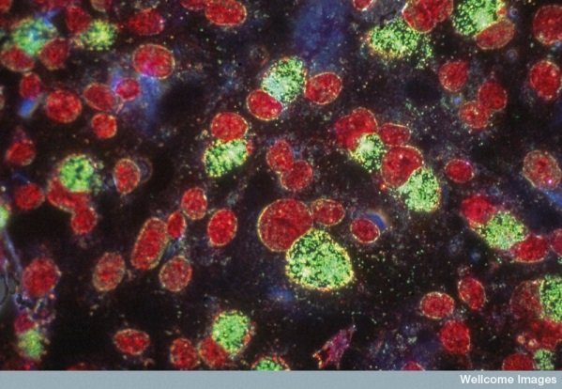
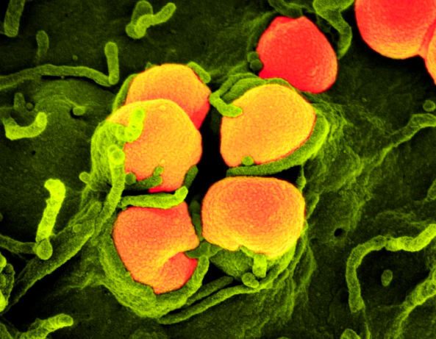
Sexual health and HIV
Julie Williams
Clinical Nurse Specialist in Sexual Health and Contraception for HIV
Julie.williams2@heartofengland.nhs.uk
Telephone 0121 424 3213

Slide 12
What we do in our clinic
Sexual health testing for all HIV positive patients ( and POCT for non positive partners)
Treatment of STI’s
Contraception
Cervical cytology
Referral to pre-conception clinic

Slide 13
BASHH guidelines
All HIV-positive individuals under regular follow-up should have:
A sexual health assessment, including a sexual history documented at first presentation and at 6-monthly intervals thereafter
Access to staff trained in taking a sexual history and who can make an appropriate sexual health assessment
Access to ongoing high-quality counselling and support to ensure good sexual health and to maintain protective
behaviours
British HIV Association, BASHH and FSRH guidelines for the management of the sexual and reproductive health of people living with HIV infection 2008

Slide 14
An annual offer of a full sexual health screen (regardless of reported history) and the outcome documented in the HIV case notes, including whether declined .
Access to investigation, diagnosis and treatment of STI’s
Annual cytology for women aged 25-64
Access to contraceptive services and provision of condoms
British HIV Association, BASHH and FSRH guidelines for the management of the sexual and reproductive health of people living with HIV infection 2008

Slide 15
Sexual health testing
chlamydia
gonorrhoea
syphilis
hepatitis
Genital warts
Thrush and BV
Genital herpes
TV

Slide 16
Treatment of infections
IM injections
Oral antibiotics/antiviral
Antifungal treatments
Topical treatments
Cryotherapy

Slide 17
Cytology
HIV positive females require annual smears
Testing age is 25-64
Opportunity to examine genital area and routine test for Chlamydia/Gonorrhoea
Full screening if symptomatic
FGM

Slide 18
Contraception
LARC’s ( IUS, IUD, Depo, Implant)
Oral contraception/patches
Condoms
Advice
Referrals
Referrals to pre-conception clinic

Slide 19
Case study 1 ……
54 year old heterosexual man. Diagnosed with HIV in ITU in 2015.
Seen in HIV clinic in 2017, routine blood test showed positive Syphilis
Reports 1 x female sexual contact since HIV diagnosis, unprotected oral sex both given and received at a swingers club.
Offered sexual health screen at time of syphilis treatment . Asymptomatic at time of testing
Pharyngeal, urethral and rectal chlamydia and gonorrhoea tests were carried out
Given his history ….

Slide 20
What do you think the tests showed?

Slide 21
One of the tests came back positive for chlamydia.
But which one ?
Urethral : negative
Pharyngeal: negative
Rectal : positive

Slide 22
Case study 2 ……
36 year old heterosexual man. Diagnosed with HIV in 2012. Lost to follow up from another clinic in 2015.
Referred via gastroenterology with a 6/12 history of rectal symptoms. Treated for IBD following sigmoidoscopy, but treatment was not working.
Referred to one of our consultants for ? HIV related cause .
Reported no sexual contact in the last 2 years.
Full sexual health screen carried out for gonorrhoea and chlamydia .
Given his history …….

Slide 23
What do you think the tests showed?

Slide 24
Urethral culture/urine :positive for gonorrhoea and chlamydia
Pharyngeal: negative
Rectal swabs : positive for gonorrhoea and chlamydia

Slide 25
And the morals of these stories…

Slide 26
Thank you for listening
and now back to Karen
Notes:
Is going to talk to you about partner notification

Slide 27
Karen Barclay - health adviser in HIV department
What is the health adviser team’s role?
Promoting HIV testing
Giving results
Support
Partner notification
Child testing
Sexual health advice

Slide 28
What is partner notification for HIV?
the process of contacting the sexual partners of a person with HIV and advising them that they have been exposed to infection
This is also applicable for any other sexually transmitted infections / BBV
Remember to include those that are exposed in a non sexual way eg: IVDU
Also consider testing children if appropriate

Slide 29
HIV and the Law

Slide 30
Do you think there is a legal obligation for those with HIV to tell their partners?
Do you think there is a legal obligation for those with HIV to co-operate with the partner notification process ?

Slide 31
And the answer is …….
NO !!!

Slide 32
Rationale for PN
Diagnose the undiagnosed so they can access life saving treatment and prevent advanced HIV and death (think about how HIV is transmitted)
Identify possible source of infection
Prevent inadvertant ongoing transmission
Urgency of PN in a seroconverter

Slide 33
When is it done? 1) new diagnosis (challenging!) 2) if a patient transfers care to our service 3) new sexual partner 4) annually

Slide 34
How is it done? 1) The look back period and if any baseline negative test ever 2) May have to think of contacts over many years (even 10+) 3) PN consultation with a health adviser / plan discuss 4) options: patient referral – the patient tells their contact provider referral – the clinic tells the contact 5) Barriers to PN 6) Follow up / verification by checking the outcome of testing 7) Timescales as per guidelines 3/12

Slide 35
Scenarios: 1) heterosexual British female age 30 diagnosed HIV positive, negative 1 year before 2 x contacts, 1 in B’ham and 1 in London 2) heterosexual British man aged 53 never tested for HIV ever before diagnosed HIV positive September 2016 10 x sexual contacts in life, all in Birmingham 3) British male MSM aged 24 tested HIV positive, negative 3 years ago 3 x contacts, 2 in B’ham, 1 out of UK

Slide 36
4) heterosexual British man age 41 tested HIV positive, negative 10 years ago? contacts x 2 (sexual), few others (IVDU) 5) heterosexual African female age 35 never tested for HIV before tested HIV positive January 2016 1 x contact, 3 children to test

Slide 37
Outcomes from these 5 x cases? total number of sexual or IVDU contacts = 20 2 have tested HIV + so far – testing of others is ongoing total number of children to test = 3 2 have tested HIV + and 1 has tested HIV negative 23 contacts to be tested from just 5 HIV + patients 4/23 tested (so far) are HIV +!

Slide 38
Transmission and infectiousness a) being diagnosed with HIV b) taking HIV treatment c) having an undetectable viral load are major factors in preventing HIV transmission! PARTNER study 2016 looked at number of transmissions after 1000 mixed status couples (one HIV + one HIV – ), in both heterosexual and MSM couples) had 58,000 episodes of unprotected sex when viral load was undetectable in HIV + partner how many transmissions occurred?...............................

Slide 39
none! viral suppression from HIV RX prevents HIV transmission ☺☺☺☺☺☺☺☺☺☺☺☺☺☺☺☺☺☺☺☺☺☺☺☺

Slide 41
Prevention (PREP) and prophylaxis (PEP/PEPSE)
PREP – effective way to protect against HIV when a negative person uses HIV treatment to prevent infection
PEP / PEPSE – post exposure prophylaxis / post exposure prophylaxis after sexual exposure
72 HOUR TIME FRAME TO GET PEP / PEPSE!

Slide 42
Final thought….. Imagine if…..

Slide 43
Thank you for listening! HIV health adviser team contact number 0121 424 2847 Julie Godwin – senior health adviser Clare Davison – senior health adviser Karen Barclay – health adviser Julie Sheridan – health adviser assistant Shumana Begum – health adviser assistant

